Slide 1










Visit pritisajja.info for more such slideshows..........
Logical Organization of Computers
PS01CMCA 02
MCA I
Units
Introduction
Processors, Memory and I/O
Instruction and Flow of Control magna
Click here to play
Gates and Boolean Algebra do eiusmod tempor
Digital Logic Circuits
Watch image here...!
Memory Elements and Counters tempor
Jump to a specific course section
PS01CMCA02
Course Content Unit 1
Tutorial
Practice Material
Sample Papers
Old papers
Website
Pritisajja.info
Acknowldgement
References

Slide 2

Name: Dr. Priti Srinivas Sajja
Communication:
  Email : priti@pritisajja.info
  Mobile : +91 9824926020
  URL :http://pritisajja.info
Academic qualifications : Ph. D in Computer Science (2000)
Thesis title: Knowledge-Based Systems for Socio-
Economic Development
Subject area of specialization : Artificial Intelligence
Publications :216 in International/ National Conferences,
Journals & Books

Slide 3

Course Content
Unit 1. Introduction
Block diagram of a simple computer and its different functional units
Number systems, Conversion
Representation of information:
  integer & floating-point number representation
  character codes
Error detection and correction
2. Processors, Memory and Input/Output
CPU organization
Instruction execution
RISC Vs. CISC
Instruction-level parallelism: pipelining, superscalar architectures
Processor-level parallelism: array computers, multiprocessors, multicomputers
Microprocessor chips, Architecture of a typical microprocessor
Memory: main memory, secondary memory, types & organization
Input/Output: common types of I/O devices, Controllers
3. Instructions and Flow of Control
Design criteria for instruction formats
Addressing techniques, Instruction types
Traps & Interrupts
4. Gates and Boolean Algebra
Gates, Boolean algebra, Truth tables
Circuit equivalence, De Morgan's theorems
5. Basic Digital Logic Circuits
Integrated circuits
Combinational circuits, Arithmetic circuits
6. Memory Elements & Counters
Latches, Flip flops
Registers, Counters
MAIN REFERENCE BOOKS :
Tanenbaum A. S. : Structured Computer Organization, 3rd Edition, Prentice-Hall of India Pvt. Ltd., 1993.
Malvino A. P.: Digital Computer Electronics,2nd Edition, Tata McGraw, Hill Pub. Co. Ltd.,New Delhi, 1990.

Slide 4
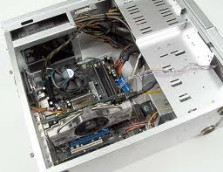
Organization of Simple Computer

Slide 5
Block Diagram of Simple Computer
Control unit
ALU
Registers
I/O Devices
Main Memory
Disk
Printer
Bus

Slide 6
History and Characteristics
History
  Software and hardware generations
How it works?
Characteristics, Applications and Advantages
Users
Input
Takes data and instructions from users
Process
Remembers data and executes instructions
Output
Presents results to the users
Working of a typical computer

Slide 7
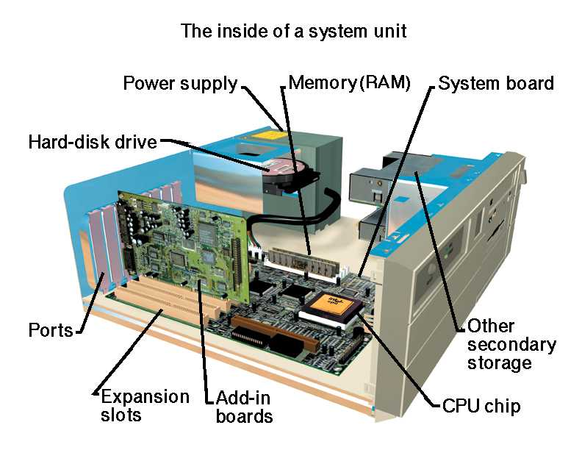
Source: Computer Architecture, JC Harambearachchi

Slide 8
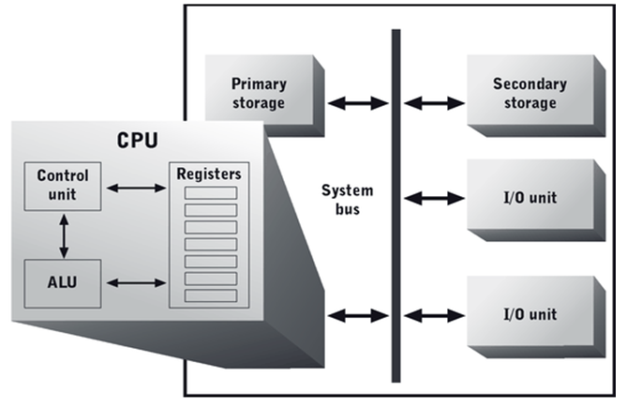
Source: Computer Architecture, JC Harambearachchi

Slide 9
Number Systems
Positional and non-positional number systems
Various number systems
  Binary number system
  Octal number system
  Decimal number system
Hexadecimal number system
Any base number system
Conversion of a numbers from one system to another
Shortcut methods
1’s and 2’s complement
Arithmetic

Slide 10
Bits, Bytes and Kilobytes, ….
A bit is the most basic unit of information in a computer.
  It is a state of “on” or “off” in a digital circuit.
  Sometimes these states are “high” or “low” voltage instead of “on” or “off..”
A byte is a group of eight bits.
  A byte is the smallest possible addressable (can be found via its location) unit of computer storage.
A word is a contiguous group of bytes.
  Words can be any number of bits (16, 32, 64 bits are common).
A group of four bits is called a nibble (or nybble).
  Bytes, therefore, consist of two nibbles: a “high-order nibble,” and a “low-order” nibble.

Slide 11

Representation of Data
Representation of Integers
Unsigned integer representation
Signed integer representation
Complement representation
Representation of Real Numbers
IEEE floating point representation
Representation of Characters
EBCDIC
ASCII
Unicode

Slide 12
Sign Magnitude Method
Represent the +41 and -41 into signed magnitude system.
Sign Bit Magnitude
Only limited numbers can be presented using this method
Positive and negative zeros are possible
Difficult to handle addition of a positive and negative numbers
0
1
0
1
0
0
1
=
+41
1
1
0
1
0
0
1
=
-41

Slide 13
-7
+0
Seven Positive Numbers and “Positive” Zero
-6
1111
0000
+1
-5
1110
0001
+2
1101
0010
-4
1100
Inner numbers:
Binary representation
0011
+3
-3
1011
0100
+4
-2
1010
0101
+5
Seven Negative Numbers and “Negative” Zero
1001
0110
-1
1000
0111
+6
-0
+7
Two different representations for 0!
Two discontinuities

Slide 14
1’s Complement Method
-51 in 1’s complement form
110011 true binary form of 51
Converting 0→1 and 1→0, we get 1’s complement ie 001100
1
0
0
1
1
0
0
=
-51

Slide 15
2’s Complement Method
-51 in 2’s complement form
110011 true binary form of 51
Converting 0→1 and 1→0, we get 1’s complement ie 001100
Add 1 in it to get 2’s complement i.e. 001101.
1
0
0
1
1
0
1
=
-51

Slide 16
2’s Complement Method
There is one unique zero. And the 2’s complement of 0 is 0.
If the left most bit is 1, then the number is negative if 0 then positive.
For n bit word with sign bit, there are 2^{n-1} –1 positive integers, 2^{n-1} negative integers and one 0, total 2^{n} unique states.
Significant information is contained in the 1s of the positive number and 0s of the negative number.
A negative number may be converted into a positive number by finding its 2’s complement.

Slide 17
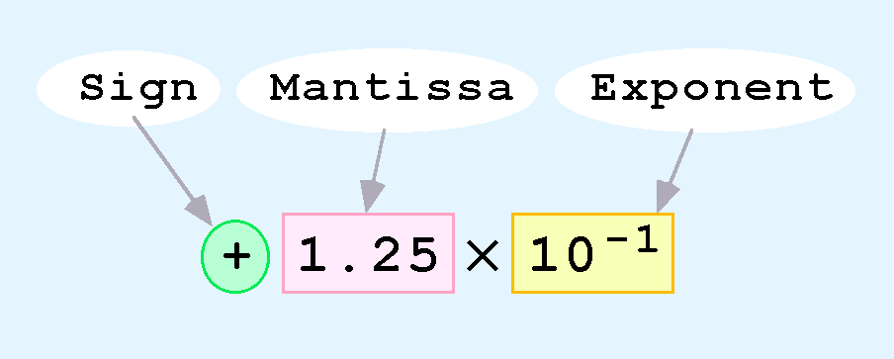
Floating Point Representations
Floating-point numbers allow an arbitrary number of decimal places to the right of the decimal point.
  For example: 0.5 × 0.20 = 0.125
They are often expressed in scientific notation.
  For example:
    0.125 = 1.25 × 10⁻¹ or 5,000,000 = 5.0 × 10⁶
Computers use a form of scientific notation for floating-point representation
Numbers written in scientific notation have three components:

Slide 18
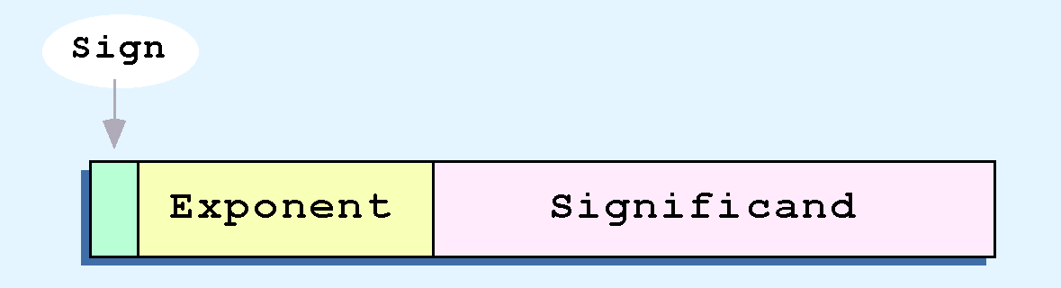
Computer representation of a floating-point number consists of three fixed-size fields:

Slide 19
IEEE FP representation
Find the IEEE FP representation of 40.15625
Step 1.
Compute the binary equivalent of the whole part and the fractional part. (i.e. convert 40 and .15625 to their binary equivalents)
40.15625₁₀ = 101000.00101₂
Step 2.
Normalize the number by moving the decimal point to the right of the leftmost one.
101000.00101 = 1.0100000101 x 2⁵

Slide 20
IEEE FP representation
Step 3.
Convert the exponent to a biased exponent
127 + 5 = 132
Also convert biased exponent to 8-bit unsigned binary:
132₁₀ = 10000100₂
Step 4.
Store the results from steps 1-3:
Sign Exponent Mantissa
(from step 3) (from step 2)
0 10000100 01000001010000000000000

Slide 21
Representation of Characters
We use a code to represent characters
  EBCDIC – Extended BCD (Binary Coded Decimal) developed for the IBM 360 and used in all IBM mainframes since then
    An 8-bit representation for 256 characters
    Still in use by IBM mainframes
  ASCII – used in just about every other computer
    A 7-bit representation plus the high-order bit used for parity
  Unicode – newer representation to include non-Latin based alphabetic characters
    16 bits allow for 65000+ characters
    It is downward compatible with ASCII, so the first 128 characters are the same as ASCII

Slide 22

Errors Detection and Correction Codes
Even Parity : An extra parity bit is set 0 or 1 so, the number of 1’s are even in the binary number/information. The 7 bits code became 8 bits code.
Odd Parity: An extra parity bit is set 0 or 1 so, the number of 1’s are odd in the binary number/information. The 7 bits code became 8 bits code.

Slide 23
Parity Bit Example
Parity bit
Even Parity :
1 1 0 0 1 1 1-------> 1 1 0 0 1 1 1 1
1 0 0 1 0 0 0 ------> 1 0 0 1 0 0 0 0
Odd Parity:
1 1 0 0 1 1 1-------> 1 1 0 0 1 1 1 0
1 0 0 1 0 0 0 ------> 1 0 0 1 0 0 0 1
Parity bit

Slide 24
The number of bit position in which two code words differ is called Hamming Distance.
For example, 1101001 and 1101101 are the two numbers having hamming distance as 1.

Slide 25

Hamming Code
It is used to construct error correcting codes for m size memory word by adding r parity bits to it.
The bits at power of 2 are parity bits inserted between the original number.
That is, bits 1,2,4,8 and 16 are total 5 parity bits added in 16 bit code.
The length of the number is now 16+5=21 bits.

Slide 26
Hamming Code
Bit 1 checks bits 1,3,5,7,9,11,13,15,17,19,21
Bit 2 checks bits 2,3,6,7,10,11,14,15,18,19
Bit 4 checks bits 4,5,6,7,12,13,14, 15,20,21
Bit 8 checks bits 8,9,10,11,12,13,14,15
Bit 16 checks bits 16,17,18,19,20,21
In general bit b is checked by those bits b₁, b₂, b₃, … b_{j} such that b₁+b₂+b₃+….b_{j}=b. For example bit 5 is checked by both 1 and 4 parity bits.

Slide 27

Hamming Code
Representation of 1111000010101110
1
1
1
1
0
0
0
0
1
0
1
0
1
1
1
0
16 bits number
5 parity bits
1
1
1
1
0
0
0
0
1
0
1
0
1
1
1
0
16 +5 bits number with added check digits

Slide 28
Hamming Code
Bit 1 checks bits 1,3,5,7,9,11,13,15,17,19,21→0
Bit 2 checks bits 2,3,6,7,10,11,14,15,18,19→ 0
Bit 4 checks bits 4,5,6,7,12,13,14, 15,20,21→0
Bit 8 checks bits 8,9,10,11,12,13,14,15→0
Bit 16 checks bits 16,17,18,19,20,21→1
1 2 3 4 5 6 7 8 9 10 11 12 13 14 15 16 17 18 19 20 21
0
0
1
0
1
1
1
0
0
0
0
0
1
0
1
1
0
1
1
1
0
16 +5 bits number with added check digits [even parity]

Slide 29

Thanks to:
Presentermedia.com
Main Reference book for the course:
Tanenbaum A. S. : Structured Computer Organization, 3rd Edition, Prentice-Hall of India Pvt. Ltd., 1993.

